Slide 1
Predicting Investor to open new restaurants Presentation

Slide 2
Predicting location for investor to open a new restaurant
Any investor do investment for Profit and without any problem like in theft or any other issues and search for best location like nearby public transport and considering crowded place where other shops and ma there they prefer location for profit.
Investor open restaurant for long term considering providing services and in return gets profit based on investment.

Slide 3
Data collection and cleaning
Collected ata for location San Franciso,California from Kaggle two CSV datasets
https://data.sfgov.org/Geographic-Locations-and-Boundaries/SF-Find-Neighborhoods/pty2-tcw4
GeoJSON data for location preferences
Pre-processed data and then normaliza data to fit for purpose
Duplicate ,highly similar or highly correlated features were dropped

Slide 4
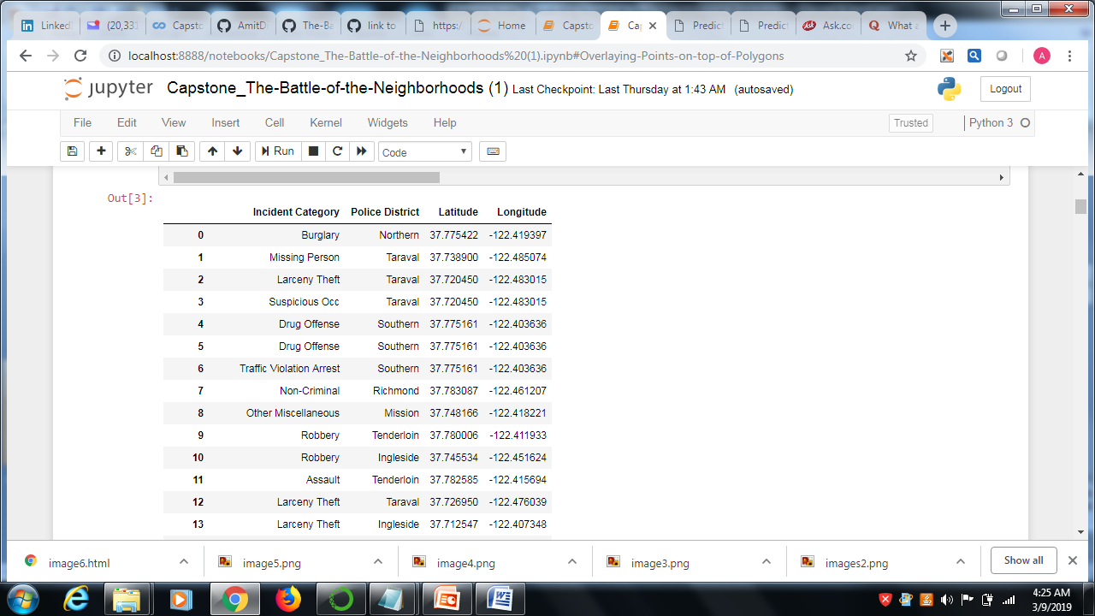
Clean and Filtered Data after preprocessing

Slide 5
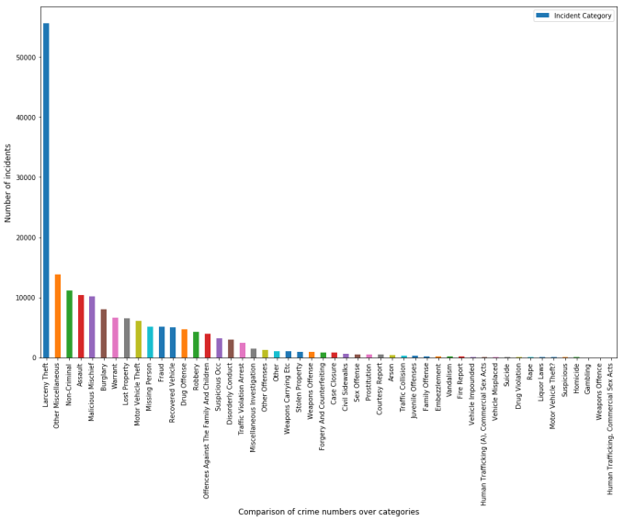
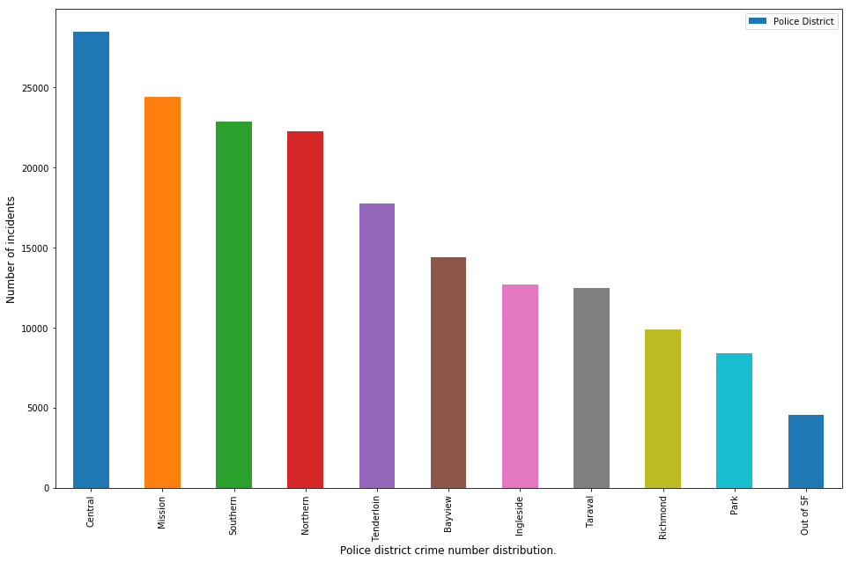
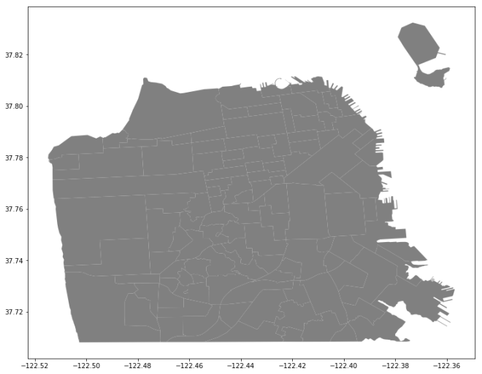
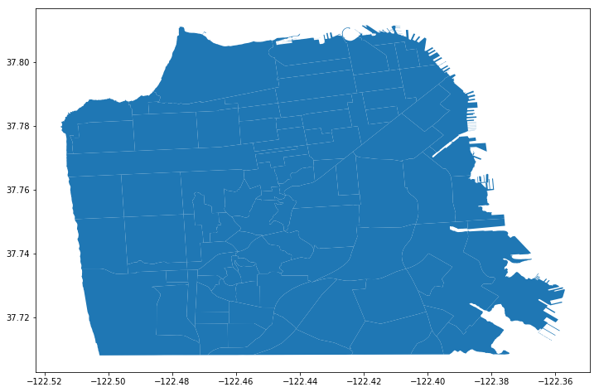
Bar charts for relation between different rows to find the crime

Slide 6
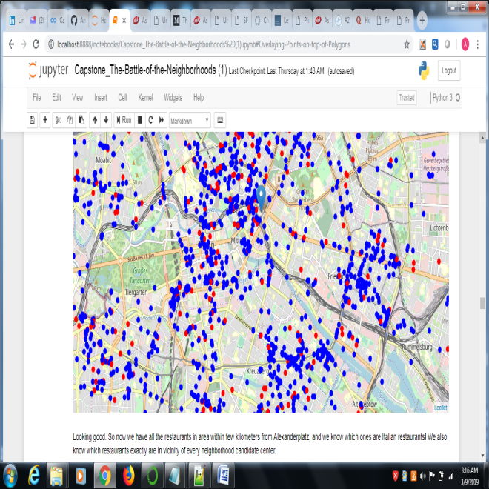
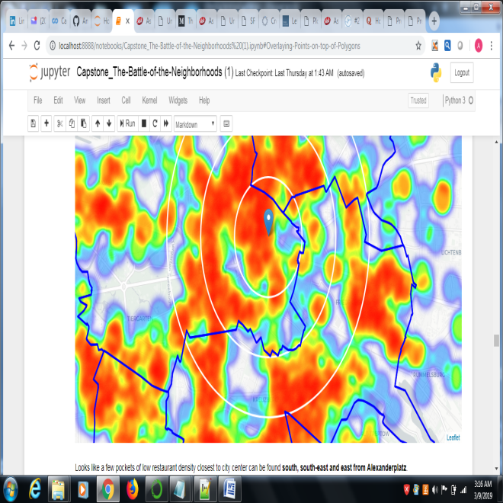
Location outcome by Map which presents crime and other factors

Slide 7
Results
Result of all this is 15 zones containing largest number of potential new restaurant locations based on number of and distance to existing venues - both restaurants in general and Italian restaurants particularly. This, of course, does not imply that those zones are actually optimal locations for a new restaurant! Purpose of this analysis was to only provide info on areas close to Berlin center but not crowded with existing restaurants (particularly Italian) - it is entirely possible that there is a very good reason for small number of restaurants in any of those areas, reasons which would make them unsuitable for a new restaurant regardless of lack of competition in the area. Recommended zones should therefore be considered only as a starting point for more detailed analysis which could eventually result in location which has not only no nearby competition but also other factors taken into account and all other relevant conditions met.
Those location candidates were then clustered to create zones of interest which contain greatest number of location candidates. Addresses of centers of those zones were also generated using reverse geocoding to be used as markers/starting points for more detailed local analysis based on other factors.

Slide 8
Conclusions and future directions
Purpose of this project was to identify San Franciso areas close to center with low number of restaurants (particularly Italian restaurants) in order to aid stakeholders in narrowing down the search for optimal location for a new Italian restaurant. By calculating restaurant density distribution from Foursquare data we have first identified general boroughs that justify further analysis , and then generated extensive collection of locations which satisfy some basic requirements regarding existing nearby restaurants. Clustering of those locations was then performed in order to create major zones of interest (containing greatest number of potential locations) and addresses of those zone centers were created to be used as starting points for final exploration by stakeholders.
Final decision on optimal restaurant location will be made by stakeholders based on specific characteristics of neighborhoods and locations in every recommended zone, taking into consideration additional factors like attractiveness of each location (proximity to park or water), levels of noise / proximity to major roads, real estate availability, prices, social and economic dynamics of every neighborhood etc.

